Slide 1
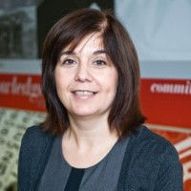
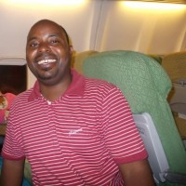
AtCMU
NOTIFICATION
Transfer to Pittsburgh video-conference
Suzana Piter Hanic
20 hours ago
NEED TO BUY
Need to buy Sharp EL 735S Calculator
Suzana Piter Hanic
1 day ago
JOB&INTERNSHIP
IT Diagnostics Analytics and Reporting Internship with Roche in Switzerland
Suzana Piter Hanic
2 days ago

Slide 2
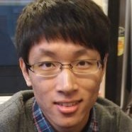
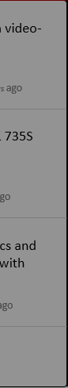





AtCMU
Sean Hao
Current Student | Global MISM
FEEDS
CONTACTS
GROUPS
SETTINGS
LOG OUT

Slide 3


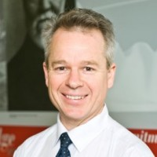
Contacts
STAFF
Suzana Piter Hanic
Manager of Student Affairs
shanic@cmu.edu.au
STUDENT
Sean Hao
Current Global MISM Student
xinhao@andrew.cmu.edu
STAFF
Ben Olijnyk
Director of Computing Services
olijnyk@cmu.edu.au

